Slide 1
Machine Learning Basics on Linear Factor Models 4. Neural networks
This slide set is largely based on Gu, Kelly, and Xiu (2020) and its Internet Appendix.

Slide 2
Background on neural networks and deep learning
The artificial neural network is arguably the most powerful modeling device in machine learning, neural networks have theoretical underpinnings as “universal approximators” for any smooth predictive association
Preferred approach for complex machine learning problems (e.g., computer vision, NLP, and automated game-playing)
Their flexibility draws from the ability to entwine many telescoping layers of nonlinear predictor interactions, earning the synonym “deep learning”
At the same time, their complexity ranks neural networks among the least transparent, least interpretable, and most highly parameterized machine learning tools
Michael Nielsen provides a great introduction to neural networks and deep learning in his book (with lots of intuitions and also Python codes). It covers all components discussed in this slide set
The URL for the book: http://neuralnetworksanddeeplearning.com/index.html

Slide 3
Neural networks (cont’d)
Traditional fit metrics are replaced by OOS (out-of-sample) forecasting and understanding the bias-variance tradeoff (e.g., the tradeoff between a more complex model versus over-fitting)
It’s data-driven and focuses on finding structure in large datasets
Key challenge with neural networks is the limited, low frequency training data and the high dimensionality of factors
Cons: overfitting is a big issue as there are many parameters to be trained
The main tools for variable or predictor selection (i.e., preventing overfitting) are regularization and dropout

Slide 4
Neural networks (cont’d)
The process through the lens of factor investing
The input matrix are the characteristics of the firms
Multiply their value by weights and add a “bias”
Perform this for all units of the first layer
The output, which is a linear combination of the input is then transformed by the activation function (frequently a logistic/sigmoid or piecewise linear/ReLu function to whether a “neuron” should be used in the process of prediction—here is where all the nonlinearities kick in)
Each unit provides one value and all of these values are fed to the second layer following the same process
This is iterated until the end of the network
The purpose of the last layer is to yield an output shape that corresponds to the label (i.e., if the label is numerical, the output is a single number; if it is categorical, then usually it is a vector with length equal to the number of categories indicating the probability that the value belongs to one particular category)

Slide 5
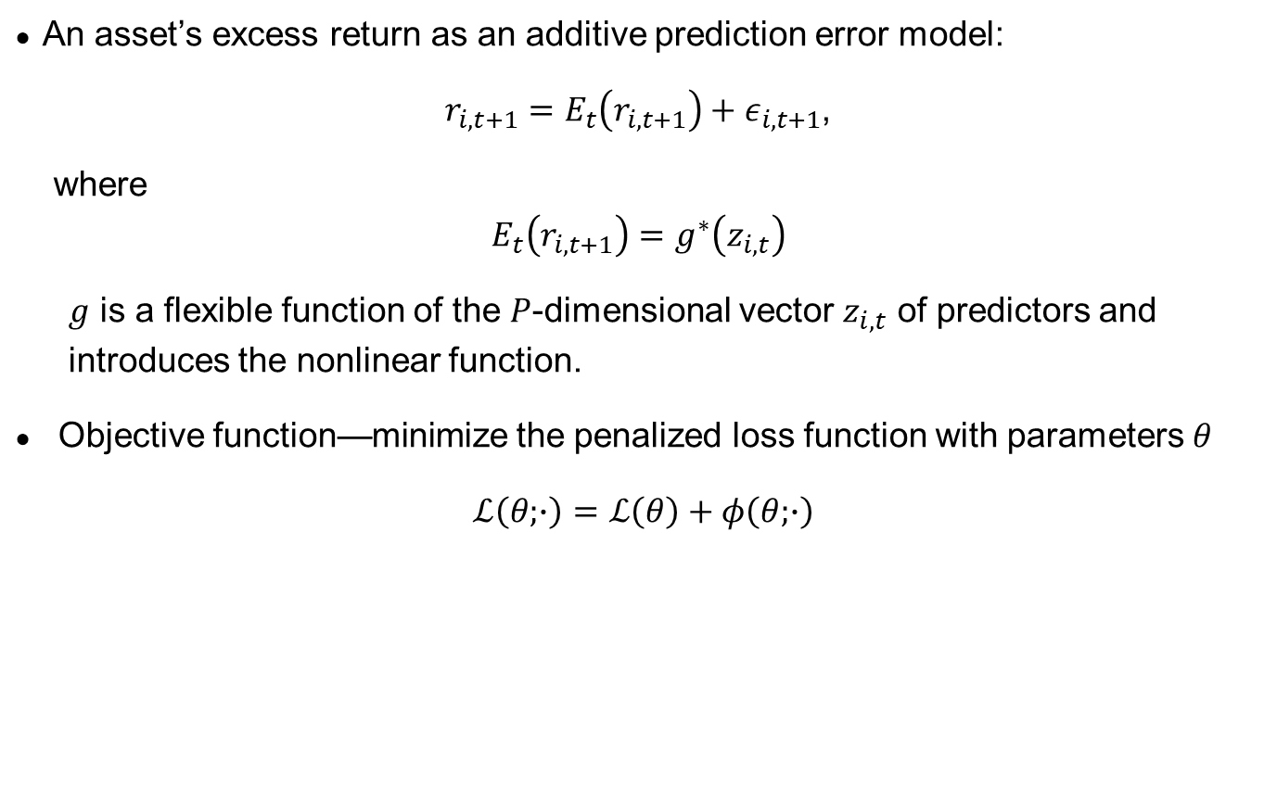
Return generating process
An asset’s excess return as an additive prediction error model:
$r_{i,t+1}=E_{t}\left(r_{i,t+1}\right)+ε_{i,t+1}$,
where
$$E_{t}\left(r_{i,t+1}\right)=g^{∗}\left(z_{i,t}\right)$$
$g$ is a flexible function of the $P$-dimensional vector $z_{i,t}$ of predictors and introduces the nonlinear function.
Objective function—minimize the penalized loss function with parameters $θ$
$ℒ\left(θ;∙\right)=ℒ\left(θ\right)+φ\left(θ;∙\right)$

Slide 6
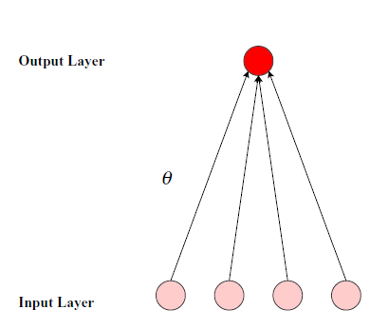
Neural networks
Standard “feed-forward” neural networks model
A form of supervised machine learning that use hierarchical layers of abstraction to represent high-dimensional nonlinear predictors
Consists of an “input layer” of raw predictors, one or more “hidden layers” that interact and nonlinearly transform the predictors, and an “output layer” that aggregates hidden layers into an ultimate outcome prediction
Simplest possible network, 4 predictors, zero hidden layer. OLS
One output layer aggregates the weighted signal to forecast:

Slide 7
NN with hidden layers
Each neuron draws information linearly from the input units, and applies a nonlinear “activation function” f to its aggregated signal before sending its output to the next layer.
E.g., second node of layer 1:
Aggregation at the output layer:
31 parameters to be estimated: (1+4)*5 + (1+5)
One hidden layer with 5 nodes (“neurons”)

Slide 8
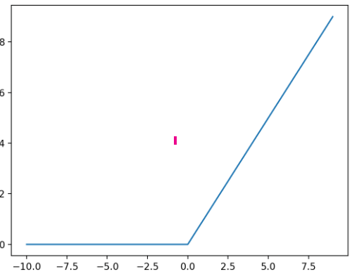
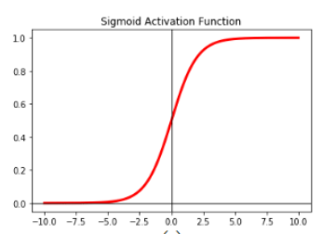
Popular activation functions
ReLU (Rectified linear unit)
Computationally efficient
Allows for faster derivative evaluation (i.e., accelerates convergence of gradient descent towards global minimum)
Sigmoid/logistic function
Most widely used activation function
Commonly used to predict probability as an output.
Differentiable and provides smooth gradient.
Check the following for more activation functions, e.g, https://www.v7labs.com/blog/neural-networks-activation-functions#:~:text=Sigmoid%20%2F%20Logistic%20Activation%20Function,to%200.0%2C%20as%20shown%20below.

Slide 9
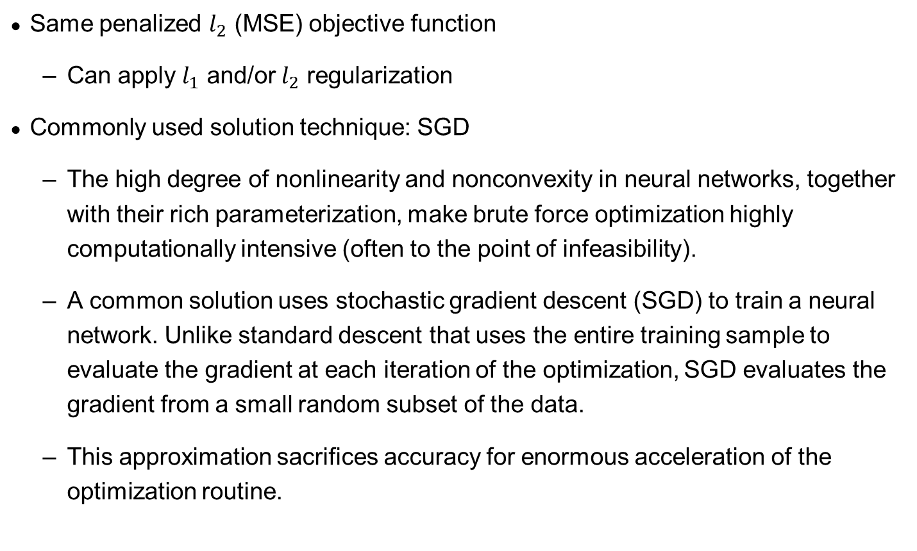
Objective function and solution
Same penalized $l_{2}$ (MSE) objective function
Can apply $l_{1}$ and/or $l_{2}$ regularization
Commonly used solution technique: SGD
The high degree of nonlinearity and nonconvexity in neural networks, together with their rich parameterization, make brute force optimization highly computationally intensive (often to the point of infeasibility).
A common solution uses stochastic gradient descent (SGD) to train a neural network. Unlike standard descent that uses the entire training sample to evaluate the gradient at each iteration of the optimization, SGD evaluates the gradient from a small random subset of the data.
This approximation sacrifices accuracy for enormous acceleration of the optimization routine.
Gradient descent (GD) is an iterative first-order optimisation algorithm (essentially a first-order partial derivative evaluated at a given point) used to find a local minimum/maximum of a given function. This article provides a very nice summary of gradient descent algorithm: https://towardsdatascience.com/gradient-descent-algorithm-a-deep-dive-cf04e8115f21

Slide 10




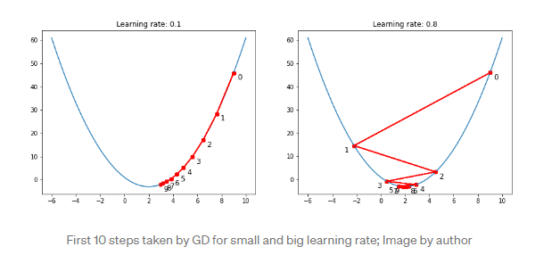
Gradient descent in a simple example
Simple quadratic function, solve for (local) minimum:
Gradient:
Numerical solution
Starting from any point p_{n}, evaluate the first-order (partial) derivative at that point. Most likely this is not zero, so we need to move to a next point. Denote the gradient at point p,
Next point for minimization: , (hence the name gradient “descent”), where controls the step size, or the “learning rate”

Slide 11
More regularization techniques
For the same reasons described above (severe nonlinearity and heavy parameterization), regularization of neural networks requires more care than the methods discussed above.
In addition to penalization of the weight parameters, other regularization techniques:
learning rate shrinkage
early stopping
batch normalization
ensembles

Slide 12
Learning rate shrinkage
A critical tuning parameter in SGD is the learning rate, which controls the step size of the descent. It is necessary to shrink the learning rate toward zero as the gradient approaches zero, otherwise noise in the calculation of the gradient begins to dominate its directional signal.
Gu et al. (2020) adopt the “learning rate shrinkage” algorithm of Kingma and Ba (2014) to adaptively control the learning rate.

Slide 13
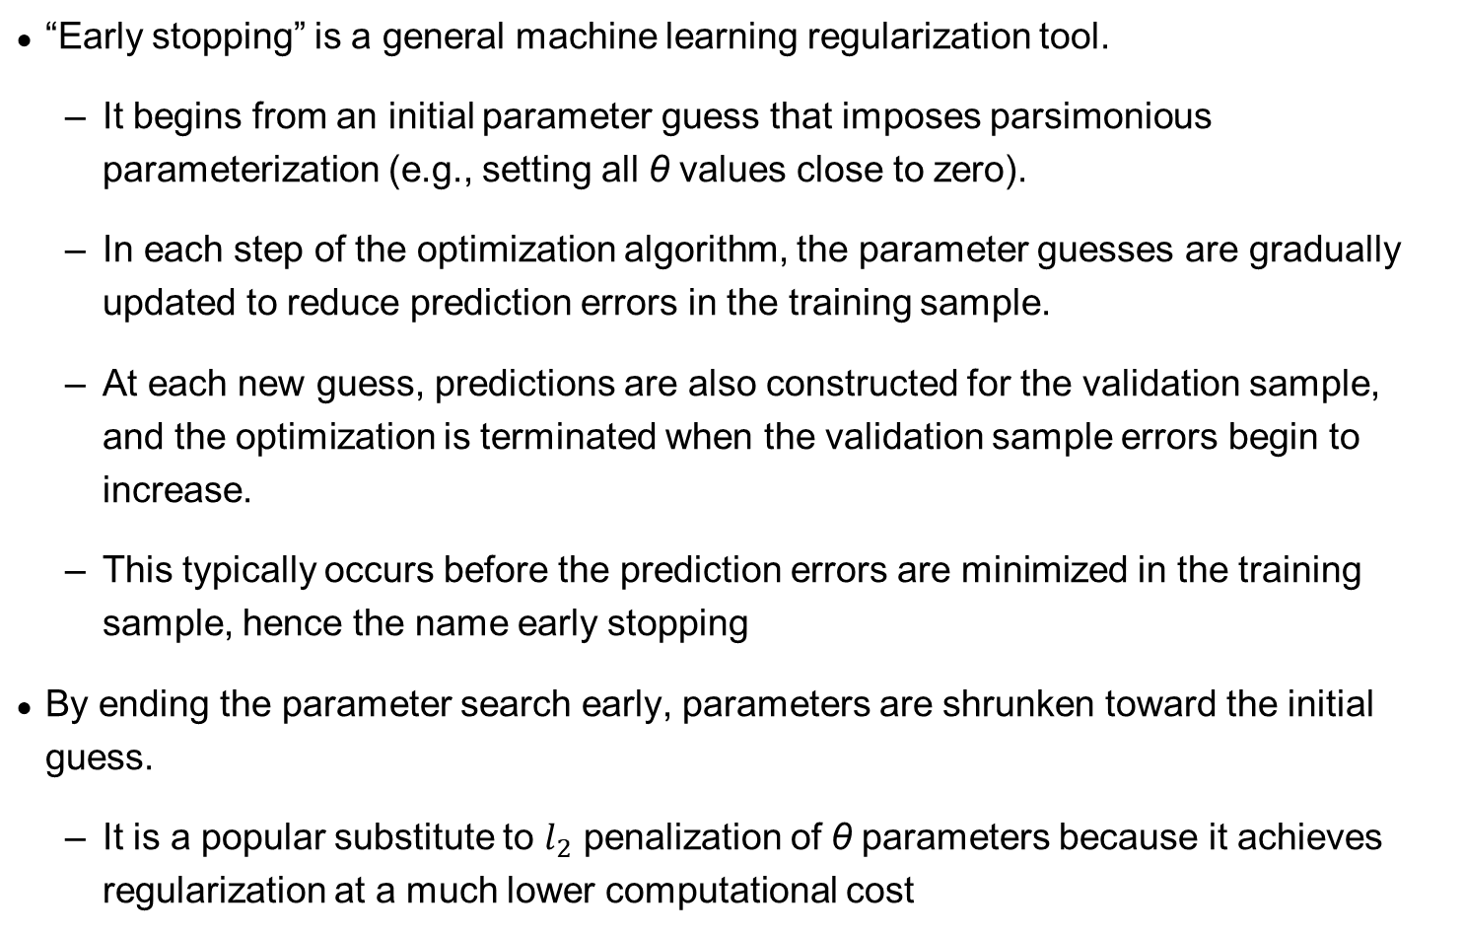
Early stopping
“Early stopping” is a general machine learning regularization tool.
It begins from an initial parameter guess that imposes parsimonious parameterization (e.g., setting all θ values close to zero).
In each step of the optimization algorithm, the parameter guesses are gradually updated to reduce prediction errors in the training sample.
At each new guess, predictions are also constructed for the validation sample, and the optimization is terminated when the validation sample errors begin to increase.
This typically occurs before the prediction errors are minimized in the training sample, hence the name early stopping
By ending the parameter search early, parameters are shrunken toward the initial guess.
It is a popular substitute to $l_{2}$ penalization of θ parameters because it achieves regularization at a much lower computational cost

Slide 14
Taming weak/strong learners with ensembles
Deep forward neural networks for “weak learners” (models that perform poorly with minuscule predictive power)
Adopt an ensemble approach in training neural networks to tame weak learners (and also averaging out strong learners)
To obtain more meaningful out of sample predictions and avoid overfitting
Averaging networks
Gu et al. (2020) use multiple random seeds to initialized neural network estimation
The model prediction is given by averaging the predictions from all trained neural networks
Simple ensemble used to handle overfitting

Slide 15
Other ensemble approach
Pasting Ensemble, Breiman, Leo (1999)
Trains individual neural networks by resampling the sample subspace
Goal to reduce computing times
Random Subspace Neural Network
Trains individual neural networks by resampling a subset of features
Goal to improve accuracy
In multifactor stock return prediction problems, this method helps solving the high dimensionality and model complexity issue by reducing the factor input dimension when training the individual learner
Random Patches Ensemble, Louppe and Geurts (2012)
Combines the idea of both the pasting and random patches ensembles

Slide 16
Improving Neural Network Ensembles: Dropout and batch normalization
Applying dropout layers (Srivastava et al. (2012)), and batch normalization (Ioffe and Szegedy (2015))
Dropout is a method designed to prevent overfitting by randomly excluding a subset of nodes during each iteration of training
In each iteration the dropout neurons will be randomly selected, and the output of each neuron will be only dependent on the remaining neurons from the previous layer
Combine dropout with input factor dropout with ensemble methods to reduce model complexity in training iterations while maintaining flexibility and diversity of the factor interaction
Batch normalization is a technique that controls the variability of predictors across different regions of the network and across different datasets.
For each hidden unit in each training step (a “batch”), the algorithm cross-sectionally demeans and variance-standardizes the batch inputs to restore the representation power of the unit

